Slide 1
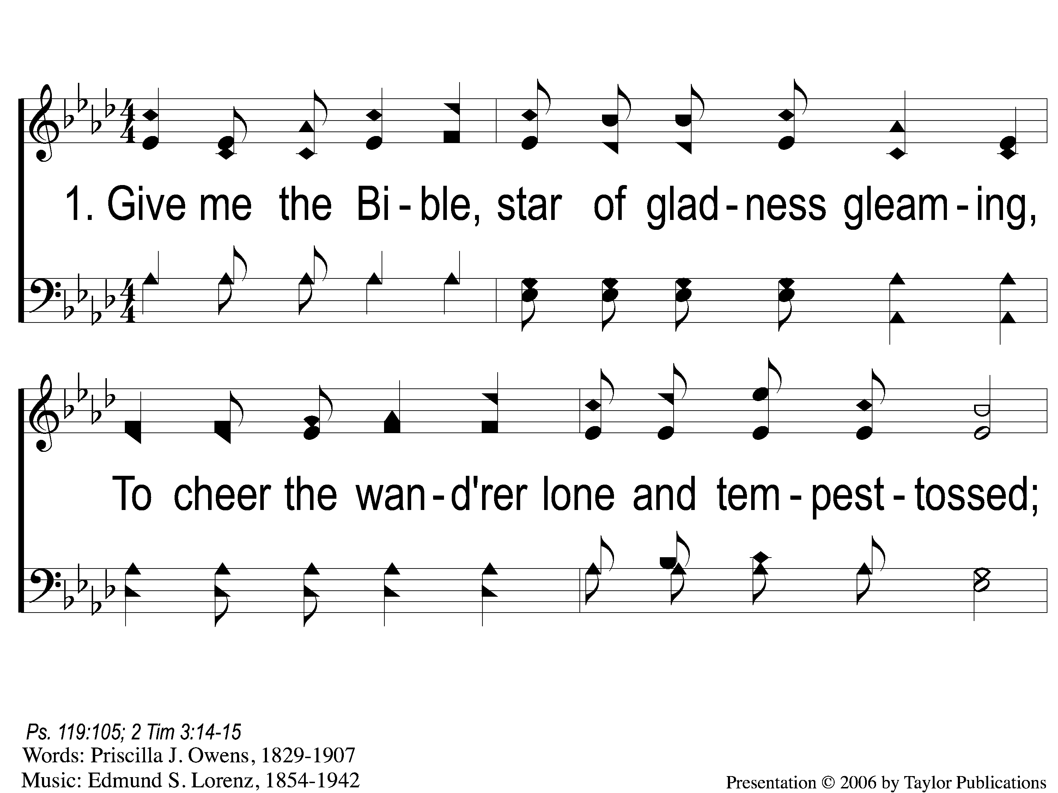
1-1 Give Me the Bible
Give Me The Bible
120

Slide 2
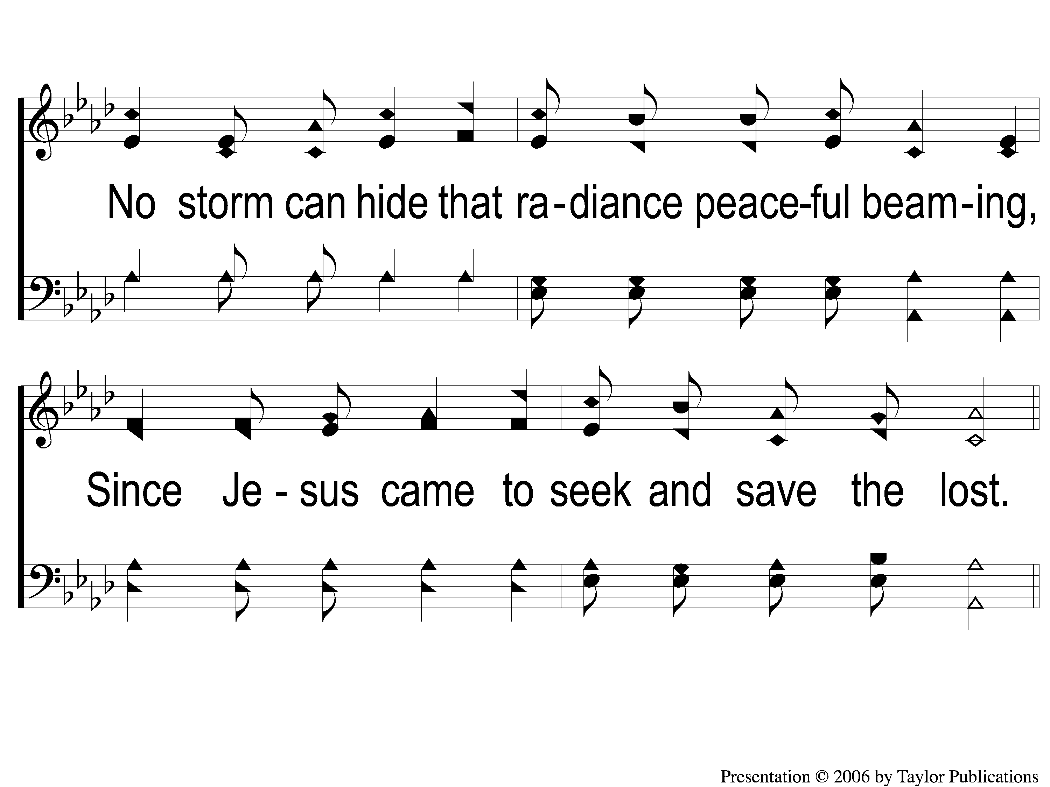
1-2 Give Me the Bible
Give Me The Bible
120

Slide 3
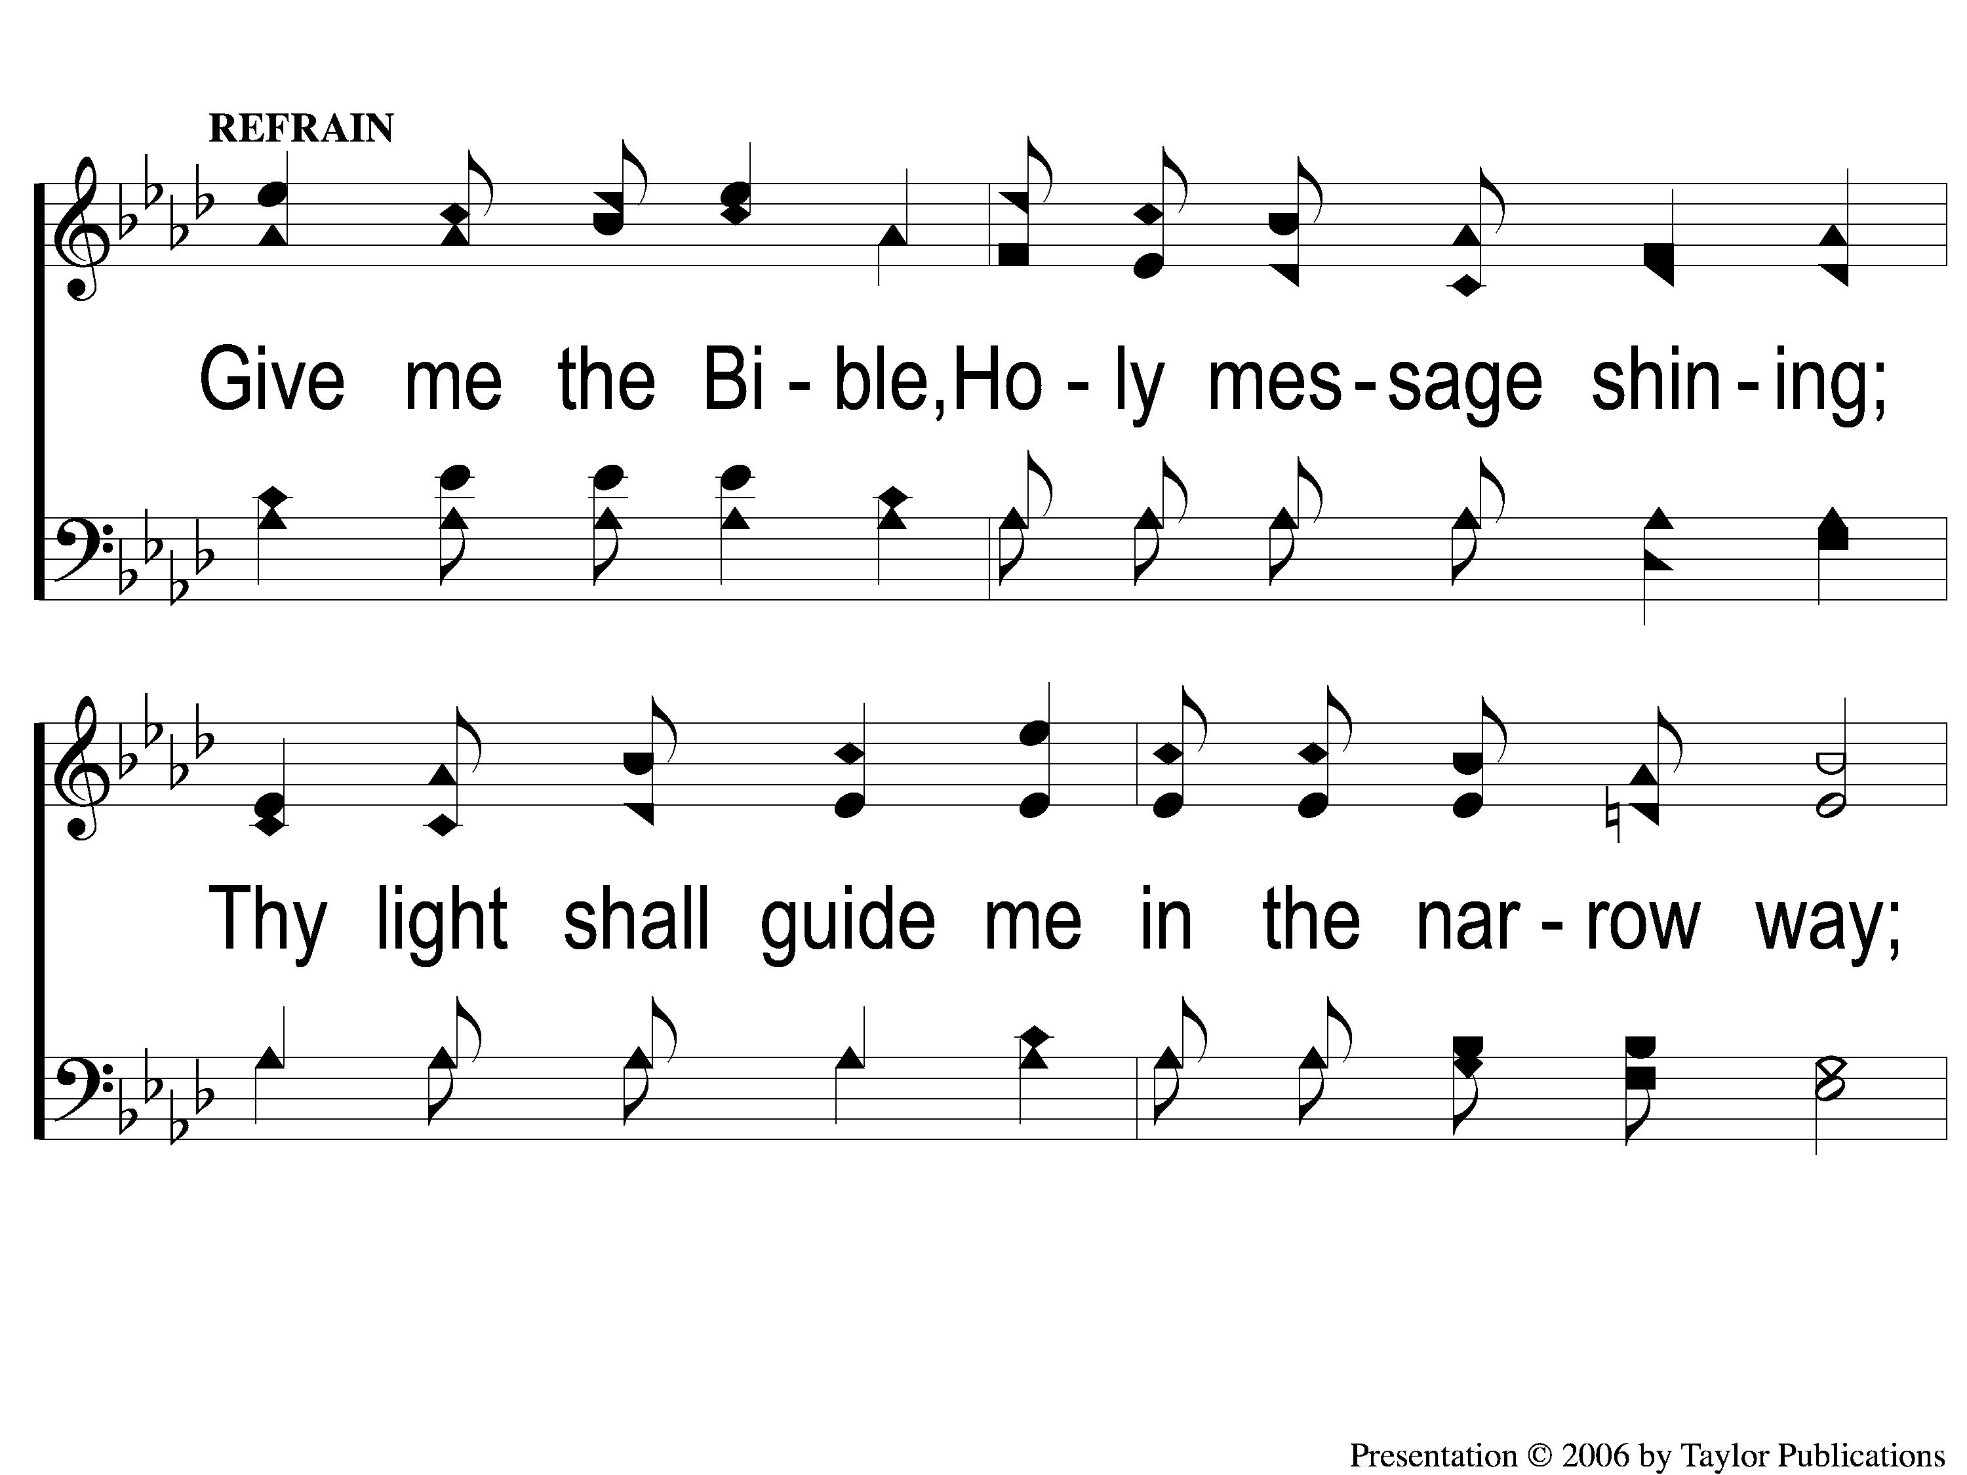
C-1 Give Me the Bible
Give Me The Bible
120

Slide 4
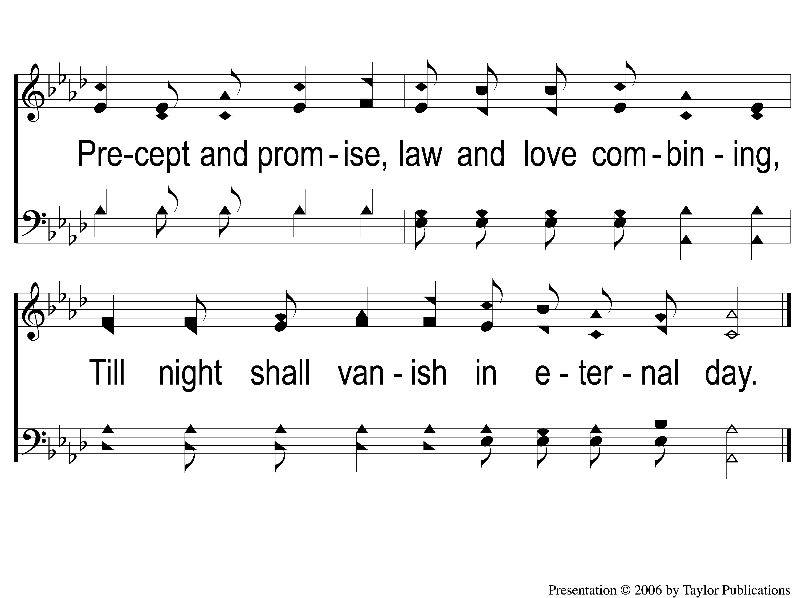
C-2 Give Me the Bible
Give Me The Bible
120

Slide 5
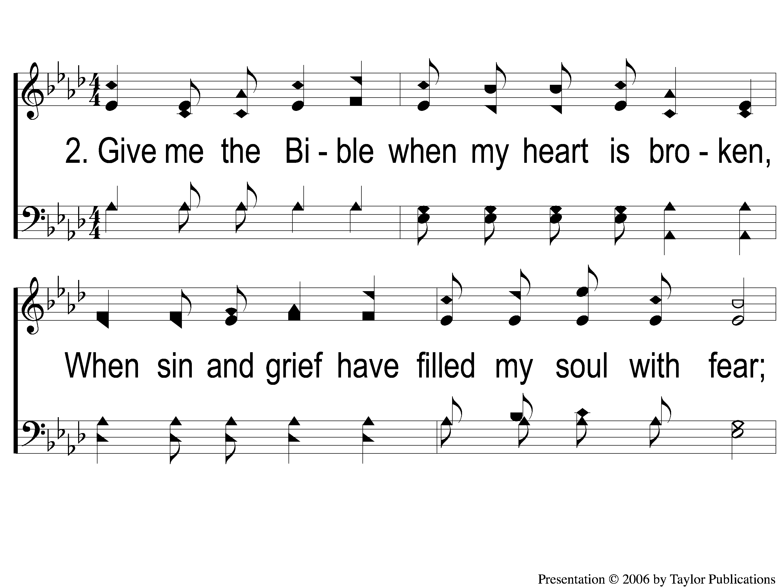
2-1 Give Me the Bible
Give Me The Bible
120

Slide 6
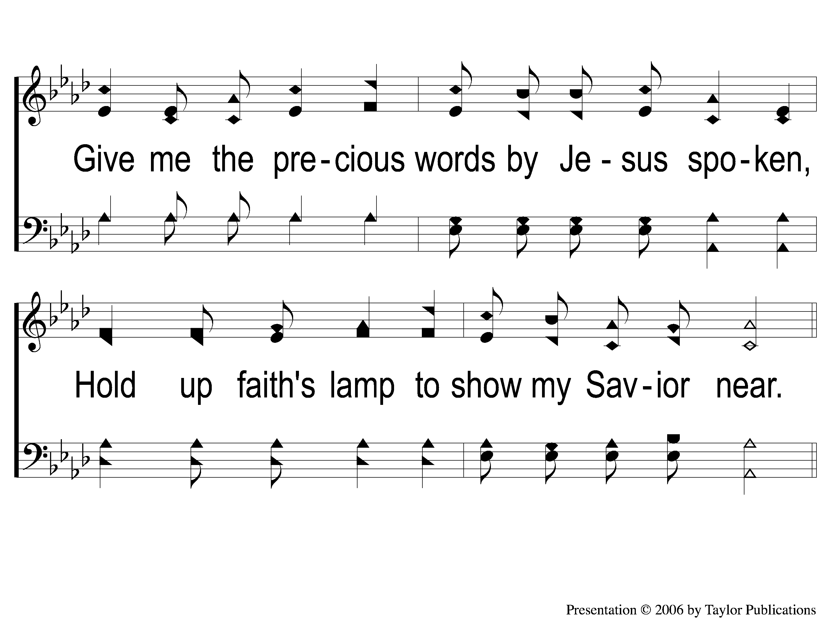
2-2 Give Me the Bible
Give Me The Bible
120

Slide 7
C-1 Give Me the Bible
Give Me The Bible
120

Slide 8
C-2 Give Me the Bible
Give Me The Bible
120

Slide 9
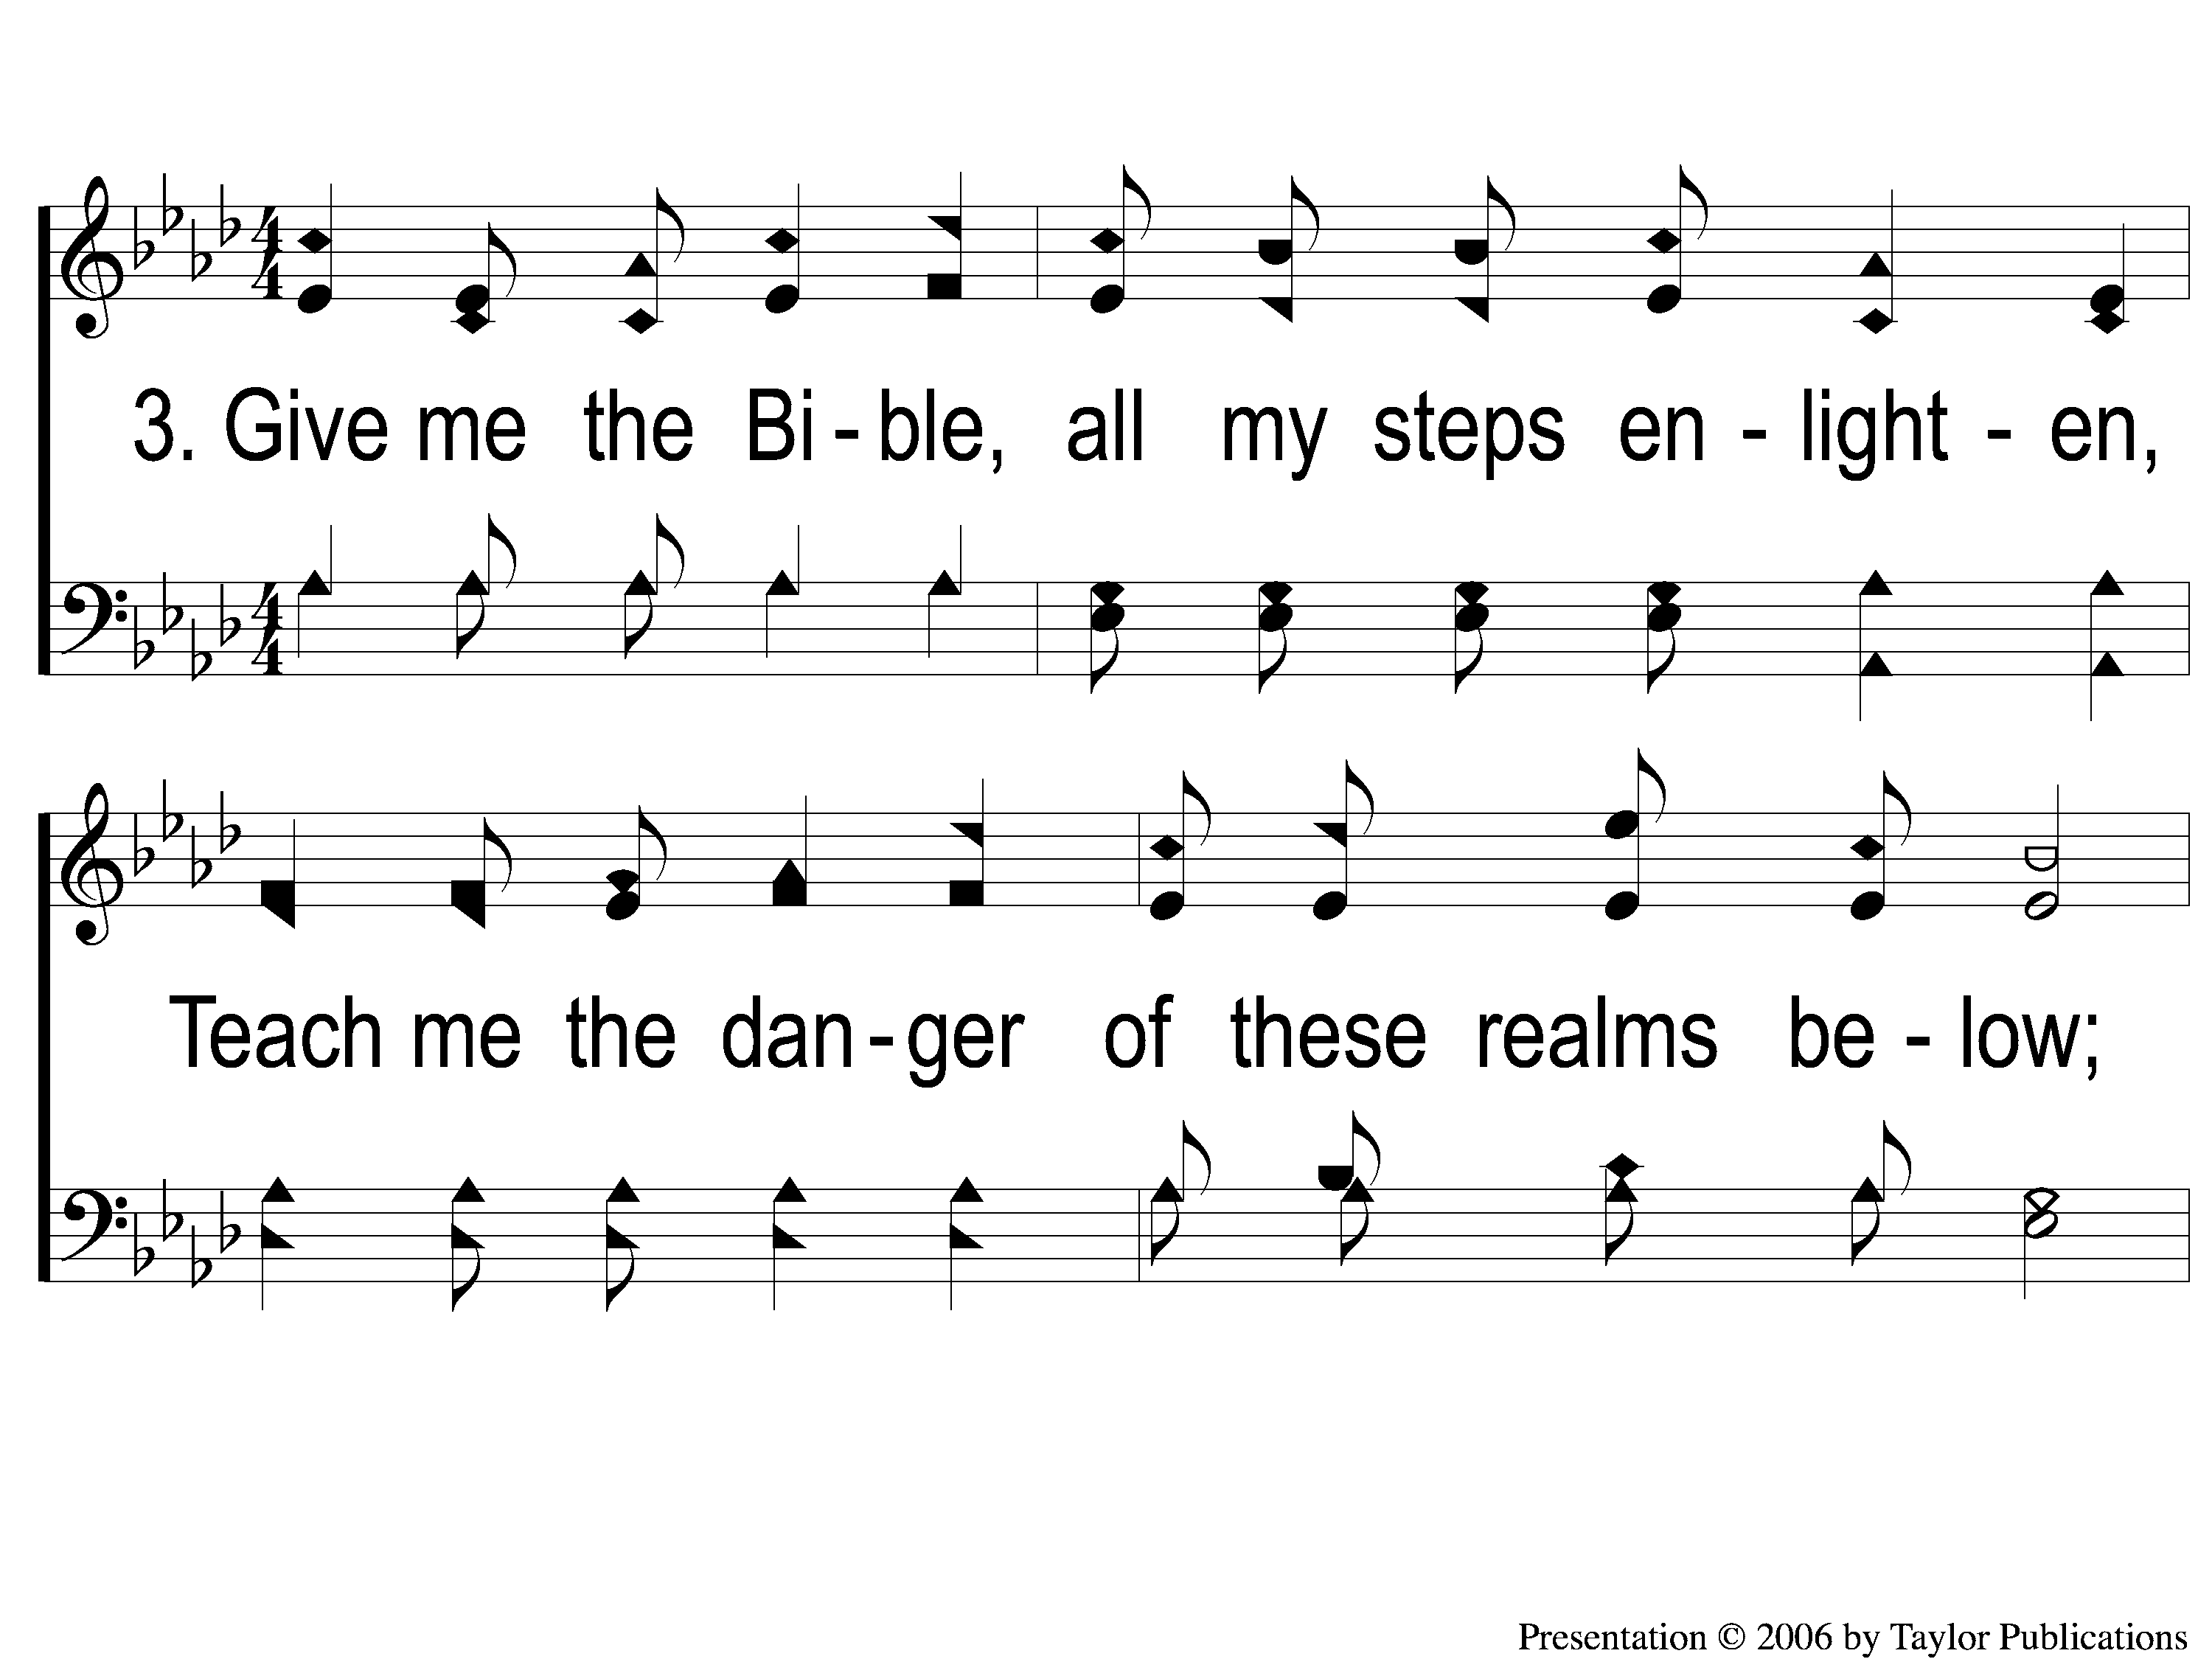
3-1 Give Me the Bible
Give Me The Bible
120

Slide 10
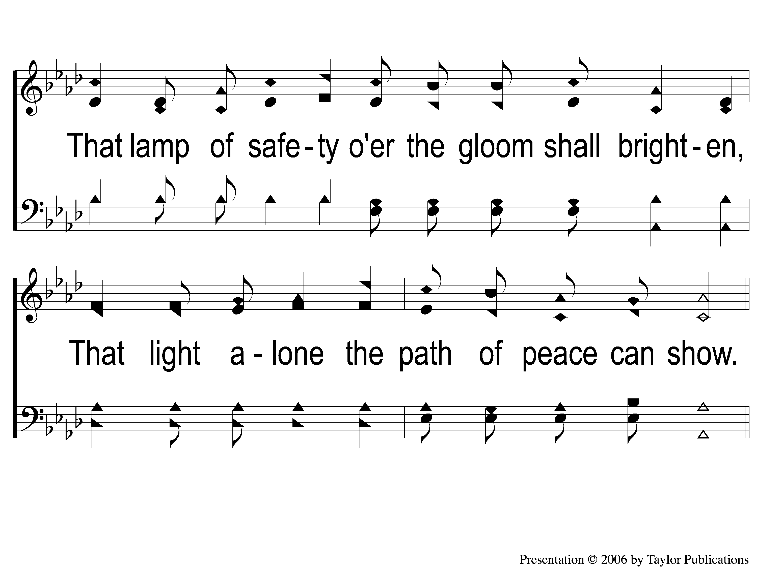
3-2 Give Me the Bible
Give Me The Bible
120

Slide 11
C-1 Give Me the Bible
Give Me The Bible
120

Slide 12
C-2 Give Me the Bible
Give Me The Bible
120

Slide 13
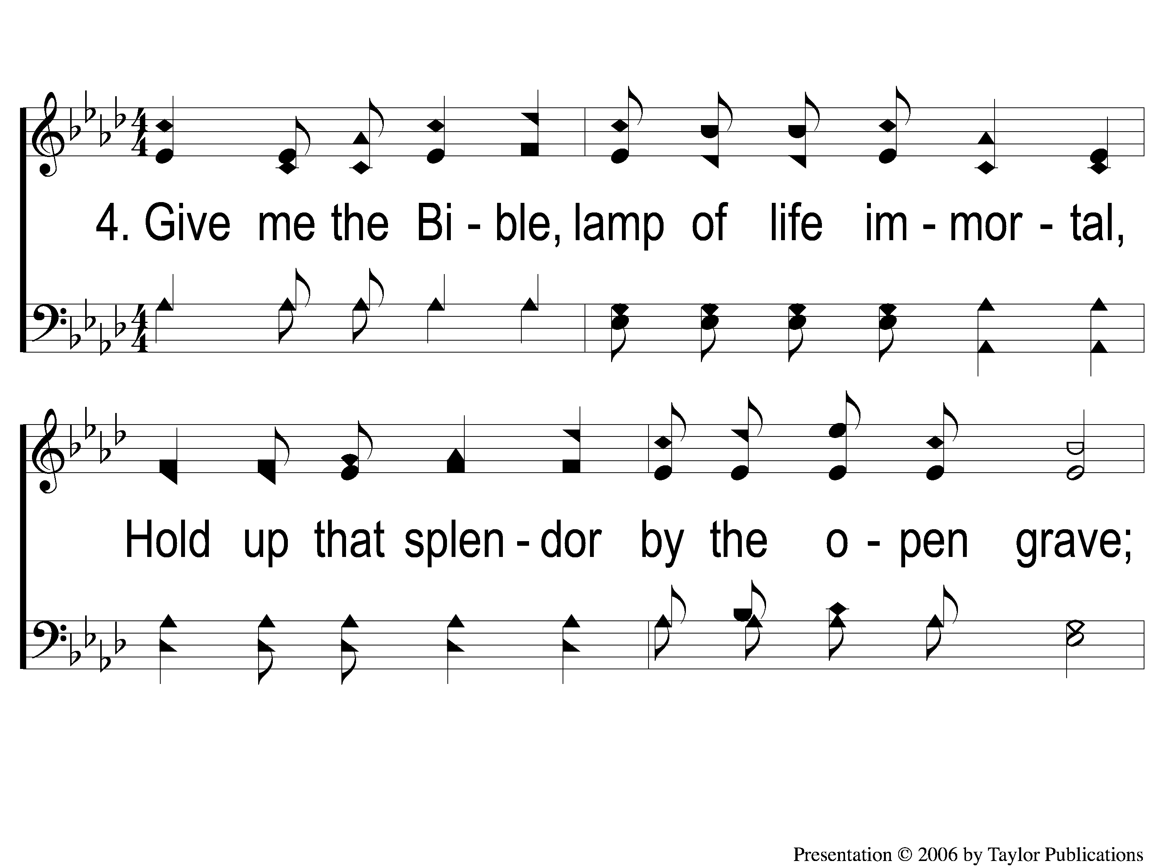
4-1 Give Me the Bible
Give Me The Bible
120

Slide 14
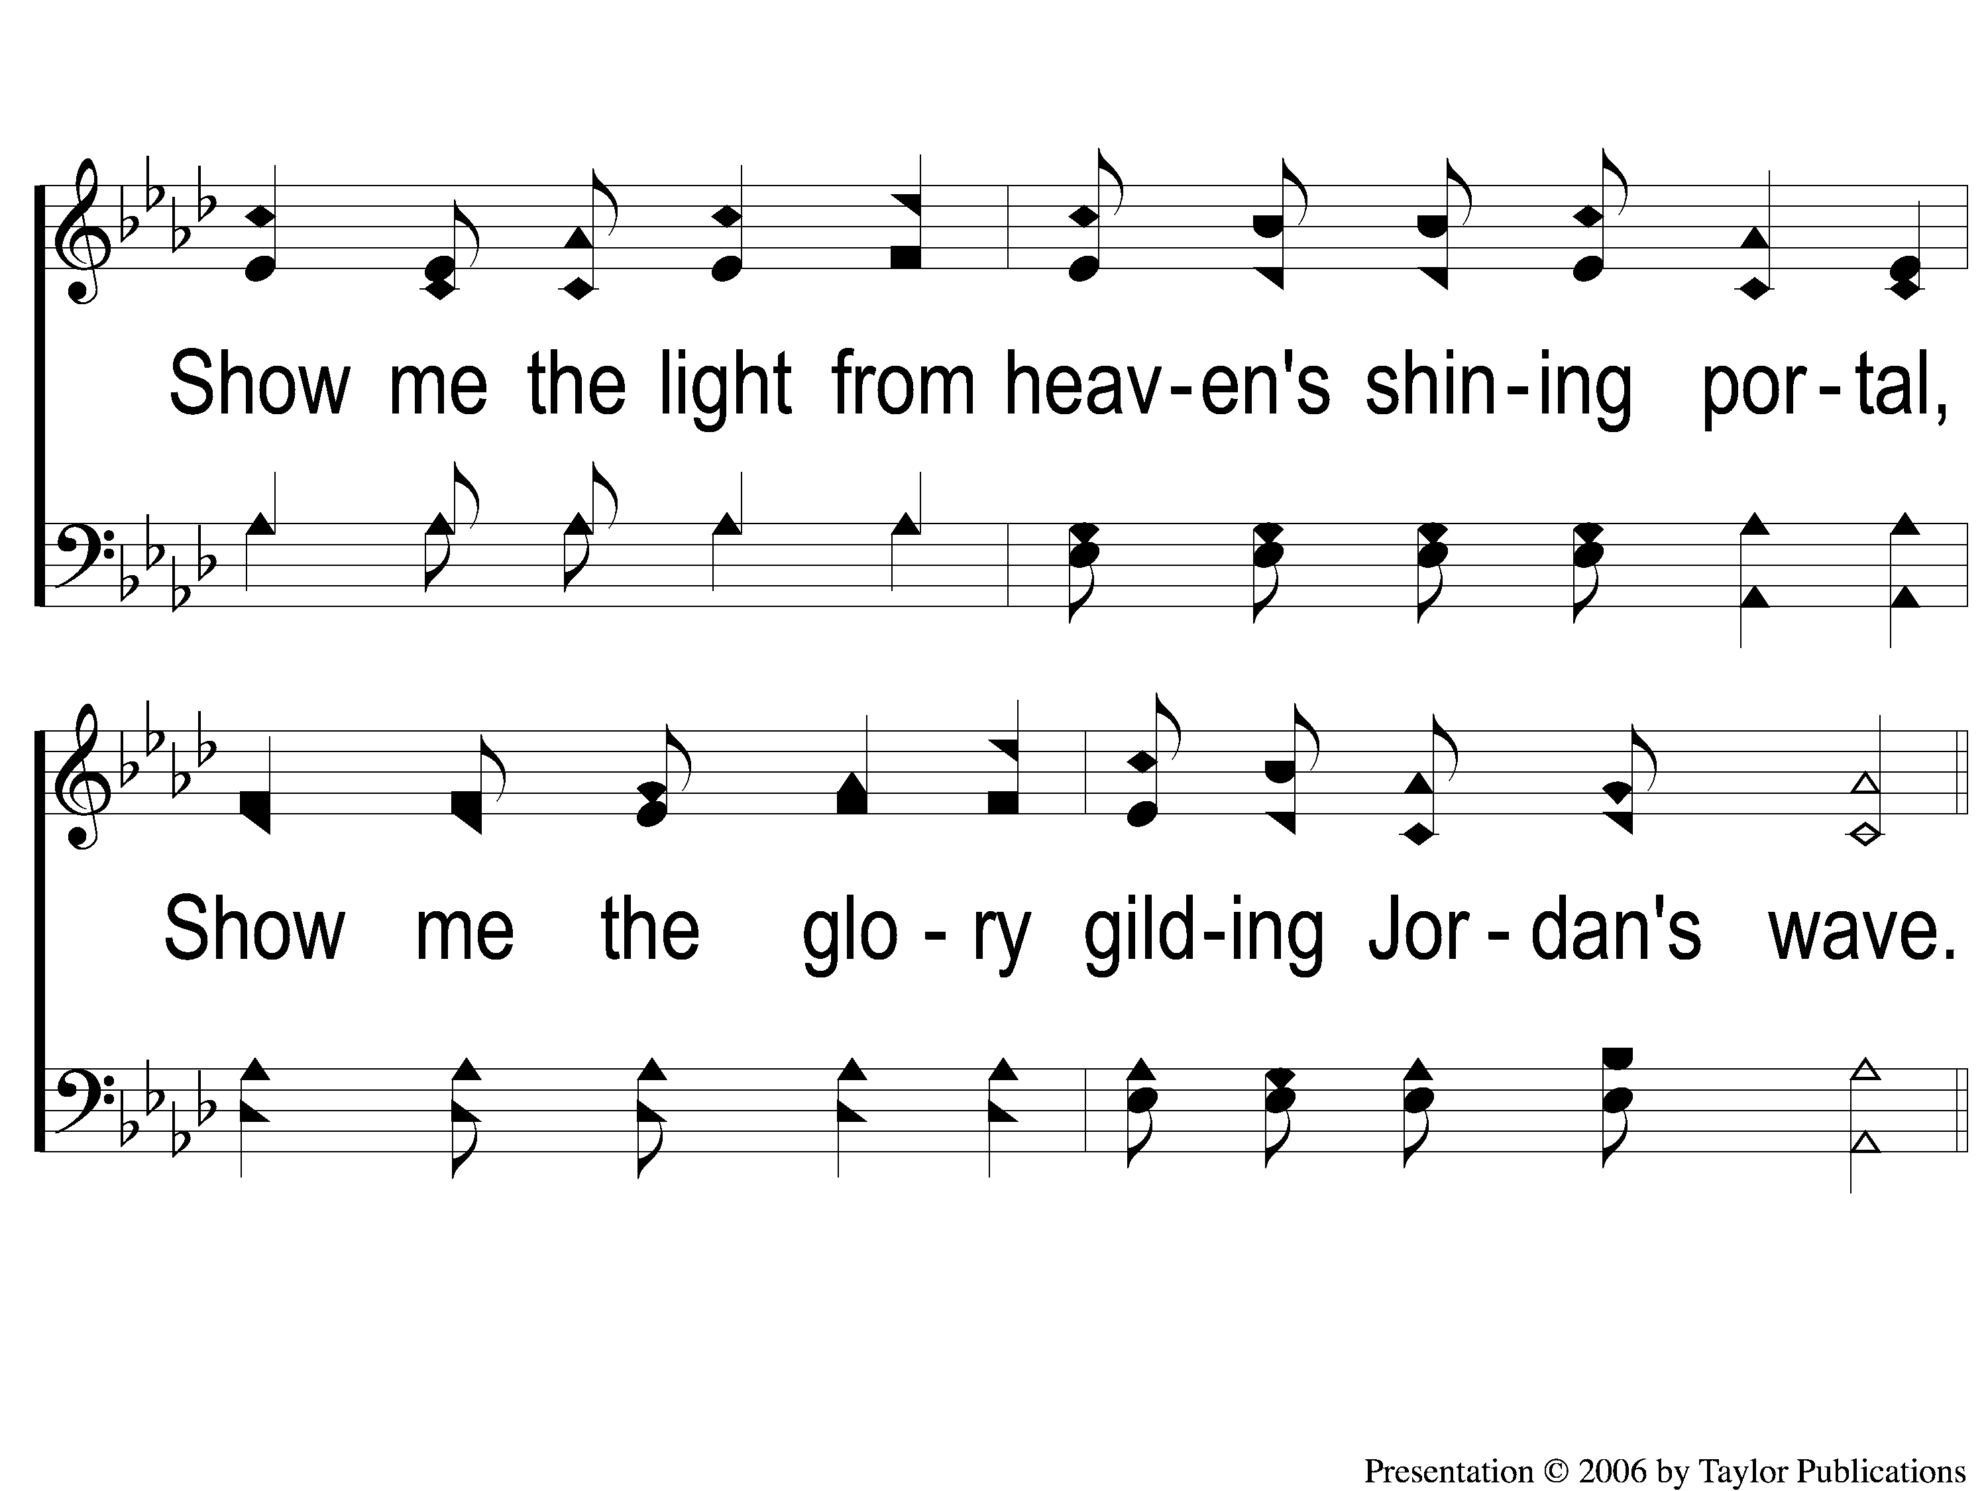
4-2 Give Me the Bible
Give Me The Bible
120

Slide 15
C-1 Give Me the Bible
Give Me The Bible
120

Slide 16
C-2 Give Me the Bible
Give Me The Bible
120

